Slide 1
How to search for relevant information?
Ronaldo Gutierrez
Date: September 23, 2016

Slide 2
Outline
Importance of finding relevant information
Definition of information
Lifecycle of information
Research process
Literature review
Peer-review process
Information gathering process
Definition of relevant information
Information sources
Information search
Citation and bibliography

Slide 3
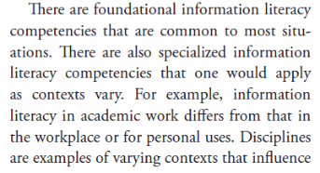
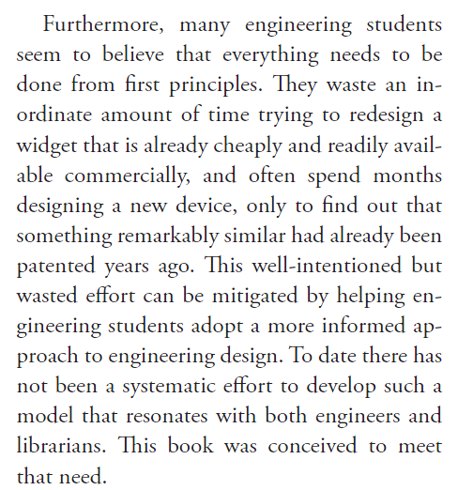
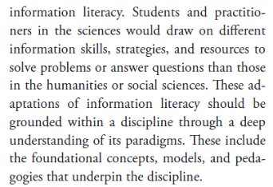
Importance of relevant information
Fosmire and Radcliffe (2014, p. vii, ix)

Slide 4
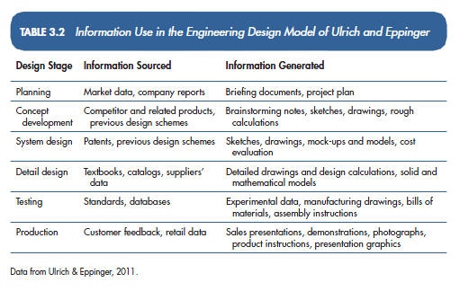
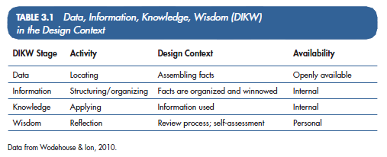
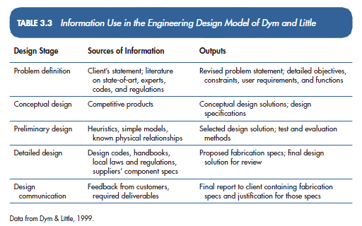
What is information?
Fosmire and Radcliffe (2014, p. 37-38)

Slide 5
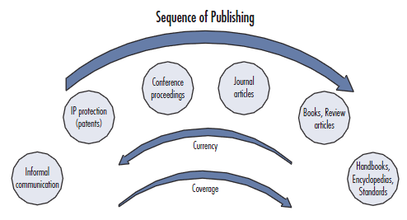
Lifecycle of information
Characteristics of technical information by Fosmire and Radcliffe (2014, p. 131)

Slide 6
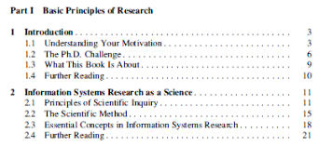
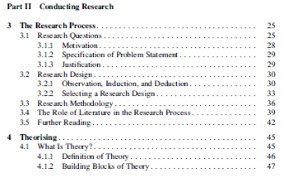
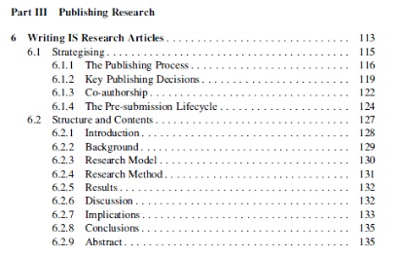
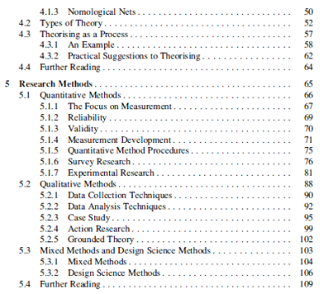
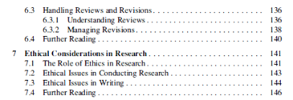
Research process
Publishing research
Conducting research
Basic principles
Adapted from Recker (2013, p.ix-xi)

Slide 7
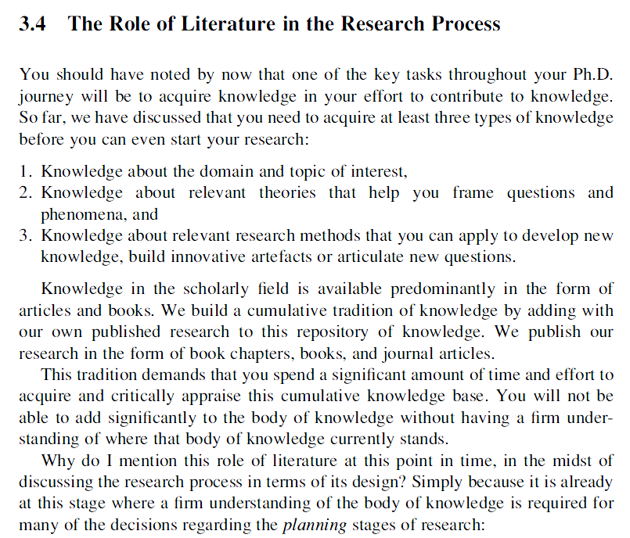
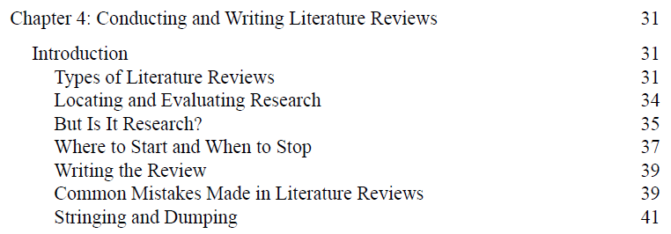
Literature review
Blair (2016, p.xii)
Recker (2013, p.39)

Slide 8
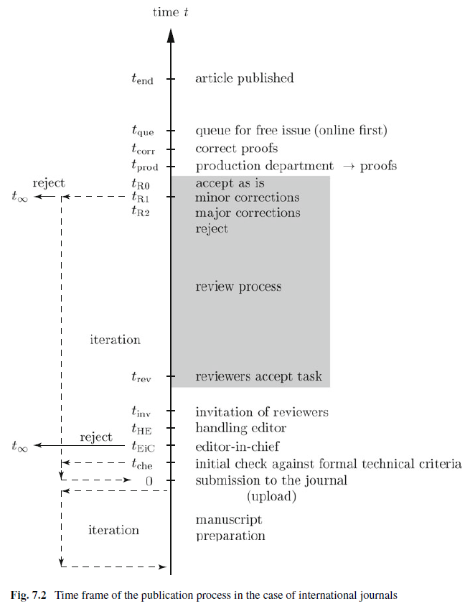
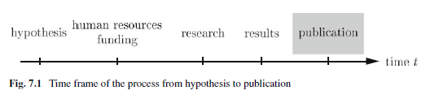
Peer-review process
Öchsner (2013, p. 66-67)

Slide 9
Information gathering process
Information gathering process
Recognizing the need of information
Locating information
Evaluating information
Applying and documenting information
Recognizing the need of information
What specific information is needed?
What information is already posed?
Locating information
Subject guides resources in the library Concordia University - Library (2016)
Appropriate search terms and logic
Logical search strategies to refine results
Capturing and organizing the results
Evaluating information
Validity (e.g., convincing arguments & substantiated claims)
Authority (e.g., background of author & field of expertise)
Relevance (e.g., is the information convincing enough to change a deeply held belief? Is it something to believe enough to stake a professional relationship?
Applying and documenting information
Extract particular information to the research question
Organize, synthesize, document, cite, and communicate the information
Use information ethically (e.g., is the information credible and under what conditions is valid?) and appropriately grounded in solid facts
Adapted from Fosmire and Radcliffe (2014, p. 22-25, 82)

Slide 10
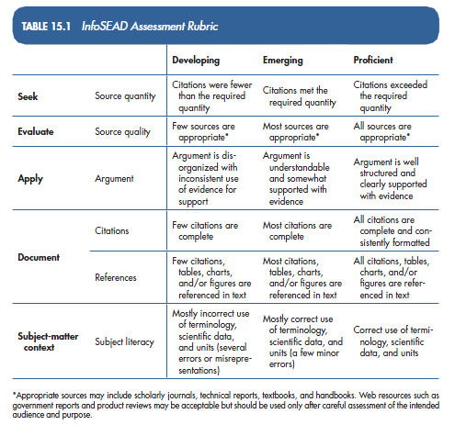
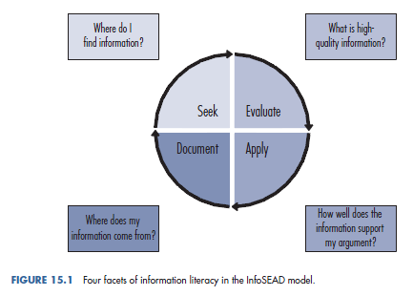
Alternative information gathering process
Fosmire and Radcliffe (2014, p. 187-190)

Slide 11
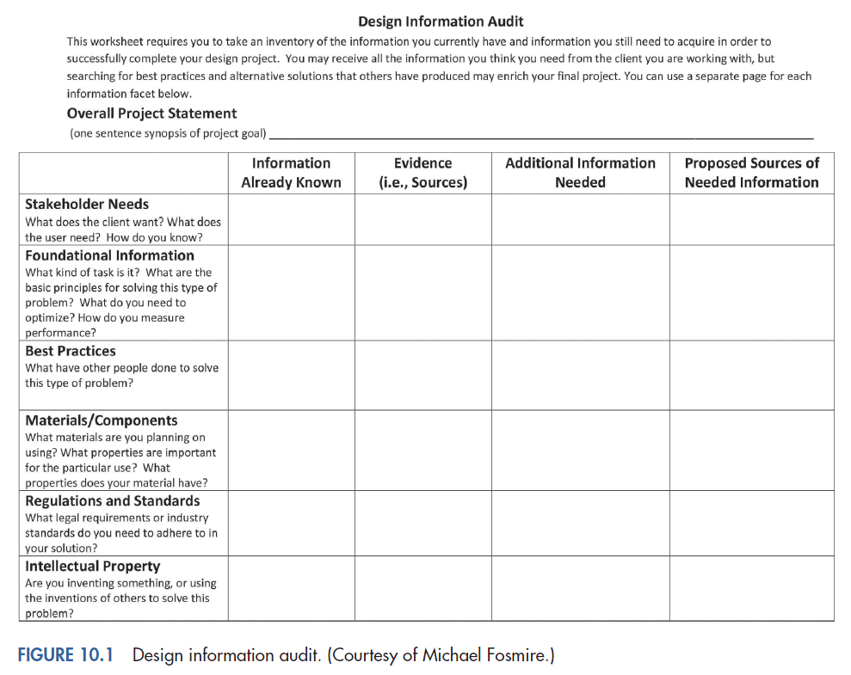
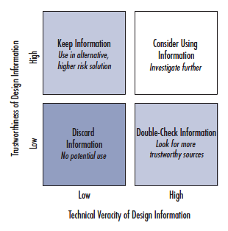
Definition of relevant information (1/2)
Evaluating the trustworthiness of information:
Authority
Accuracy
Objectivity (of both the author/creator and the publisher)
Currency
Scope/Depth/Breadth
Intended audience/level of information
Fosmire and Radcliffe (2014, p. 130, 139-141)

Slide 12
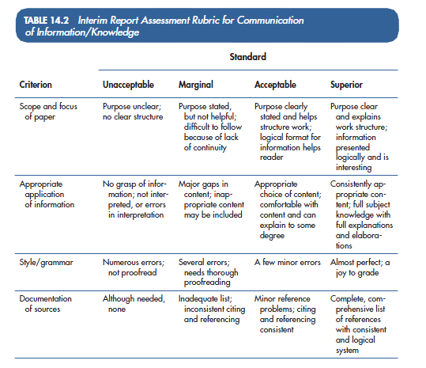
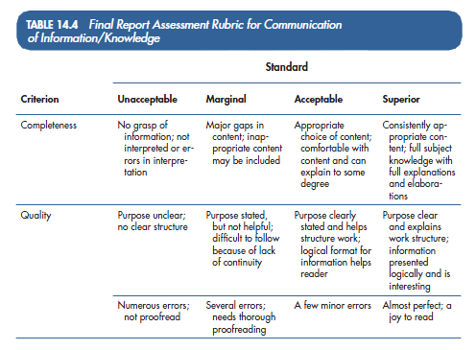
Definition of relevant information (2/2)
Fosmire and Radcliffe (2014, p. 178-179)

Slide 13
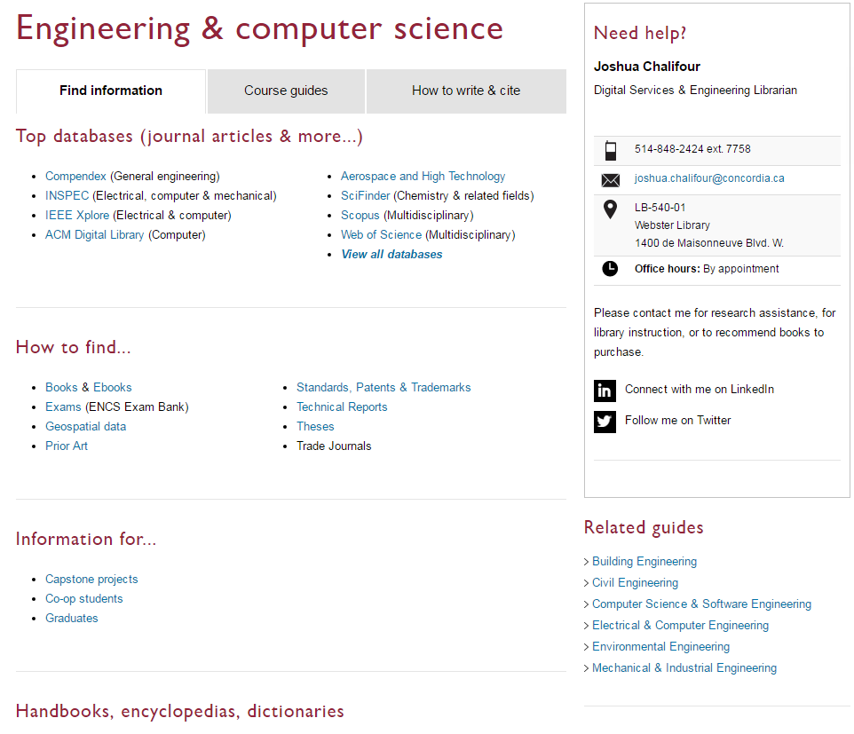
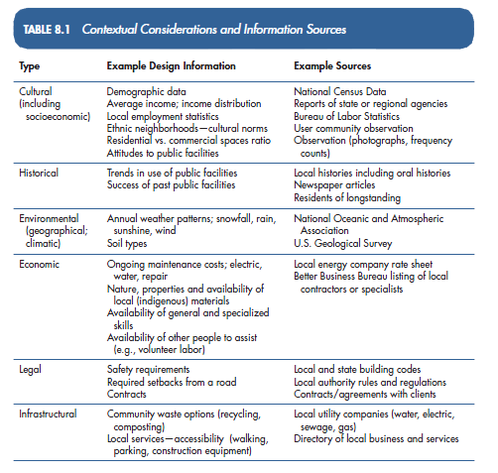
Information sources
Fosmire and Radcliffe (2014, p. 108)
Concordia University - Library (2016)

Slide 14
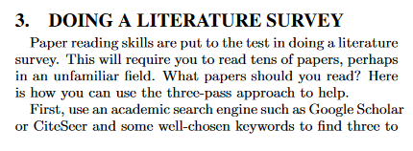
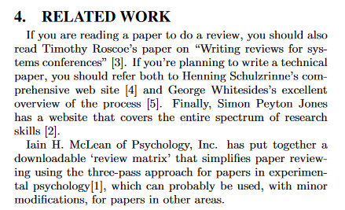
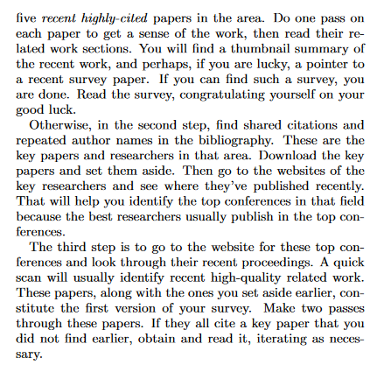
Information search (1/2)
Keshav (2016)

Slide 15
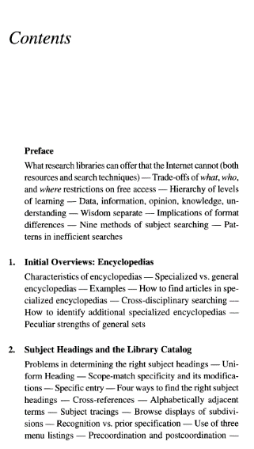
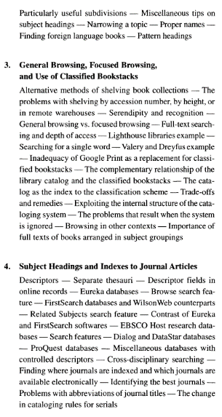
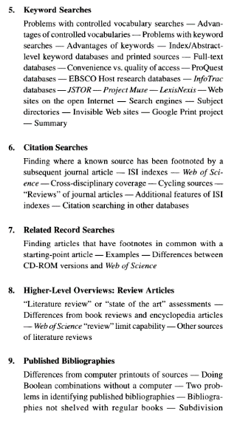
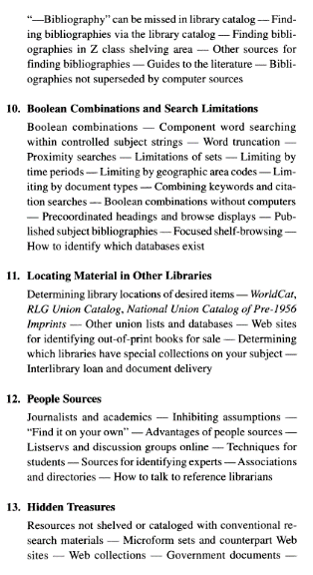
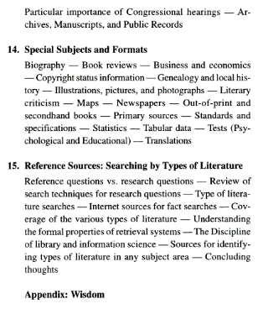
Information search (2/2)
Remark: You can refer to the newest edition
Mann (2005, p. vii-xi)

Slide 16
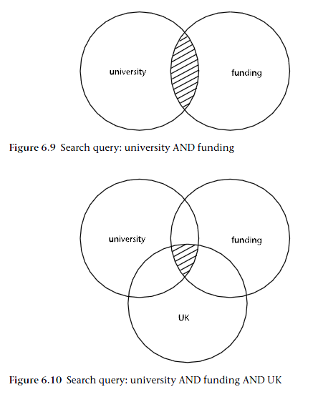
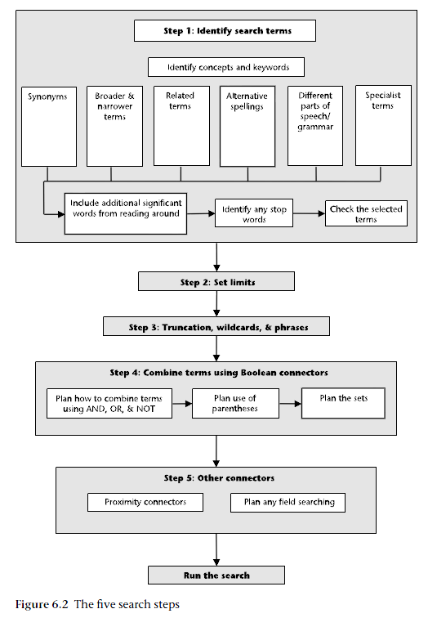
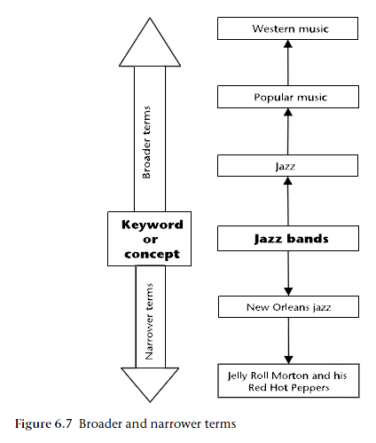
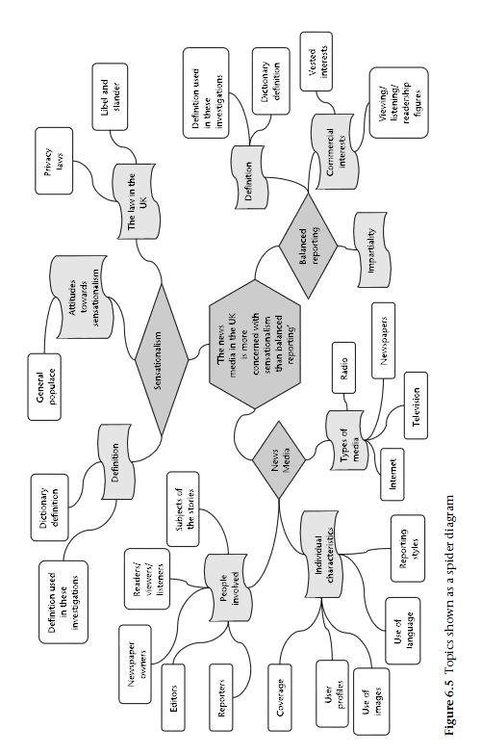
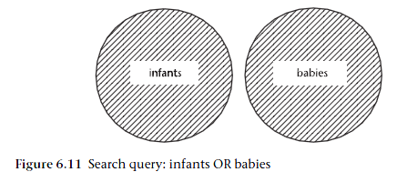
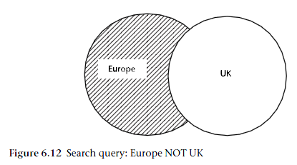
Online Information search
Rumsey (2008, p. 53, 57, 60, 69-71)

Slide 17
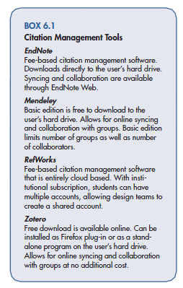
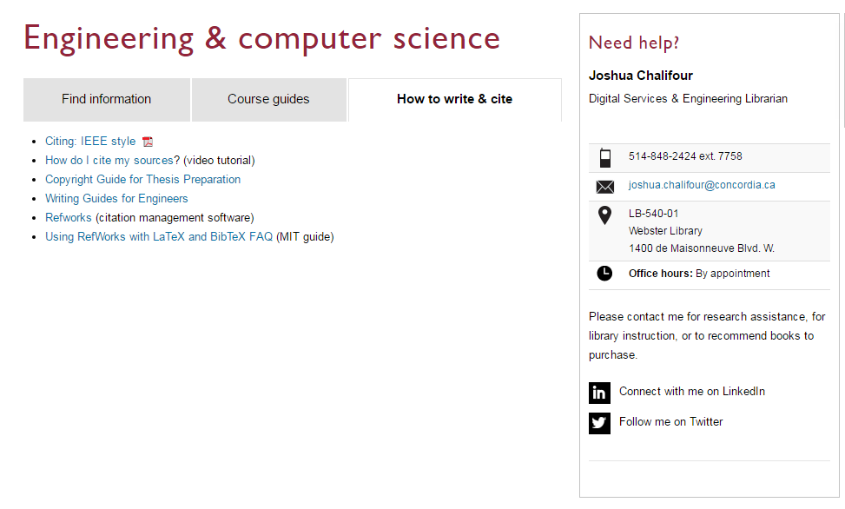
Citation & Bibliography
Concordia University - Library (2016)
Fosmire and Radcliffe (2014, p. 79)

Slide 18
References
Blair, L. (2016). Writing a Graduate Thesis or Dissertation: Sense Publishers.
Concordia University - Library. (2016). Subject & course guides. Retrieved from http://www.concordia.ca/library/guides.html#subject
Concordia University - Library. (2016). Engineering & computer science. Retrieved from http://www.concordia.ca/library/guides/encs.html
Fosmire, M., & Radcliffe, D. F. (2014). Integrating information into the engineering design process. West Lafayette, Indiana: Purdue University Press.
Keshav, S. (2016). How to read a paper. Retrieved from http://blizzard.cs.uwaterloo.ca/keshav/home/Papers/data/07/paper-reading.pdf
Mann, T. (2005). The Oxford guide to library research (3 ed.). New York: Oxford University Press.
Öchsner, A. (2013). Introduction to scientific publishing: backgrounds, concepts, strategies: Springer.
Recker, J. (2013). Scientific research in information systems : a beginner's guide: Springer.
Rumsey, S. (2008). How to find information: a guide for researchers (2 ed.): Open University Press.

